Slide 1
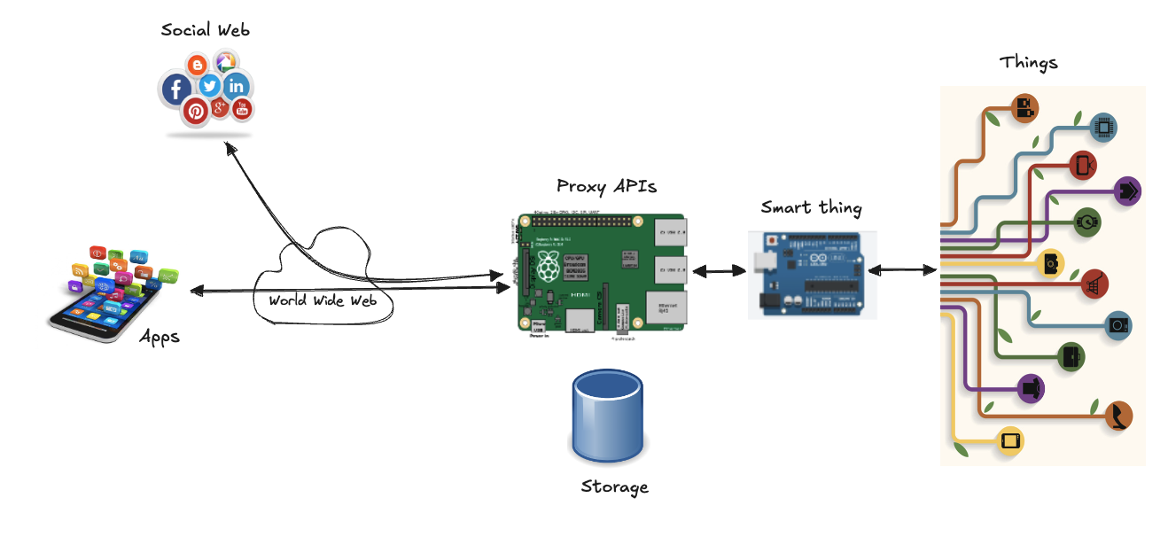
WoT Proxy

Slide 2
Implementation
Integration Strategy: choose a pattern to integrate Things to the Internet and the Web
Resource Design: identify the functionality or services of a Thing, organize the hierarchy of these services
Representation Design: decide which representations will be served for each resource
Interface Design: decide on which commands are possible for each service, along with which error codes
Resource Linking Design: decide how the different resources are linked to each other

Slide 3
Integration Strategy
Where do we implement the API of the Things to integrate it to the Web?
not all Things are equal!
some can have Internet access and implement Web protocols natively
for others (power or computationally constrained) Web protocols are challenging
Direct integration pattern
a Web Thing can directly offer a Web API
which means it can support HTTP/WS and TCP/IP
Gateway integration pattern
a more powerful device talks to devices using non-Web protocols and exposes services via a Web API
for devices that don’t connect directly to Internet (e.g. only support Bluetooth or ZigBee) or when they have very limited resources and cannot serve HTTP requests
Cloud integration pattern
a powerful and scalable Web platform acts as a gateway
for any device that can connect to a cloud server over the Internet (regardless if it uses HTTP or not) and needs more capability that it would be able to offer alone
Measurify (https://measurify.org/)

Slide 4
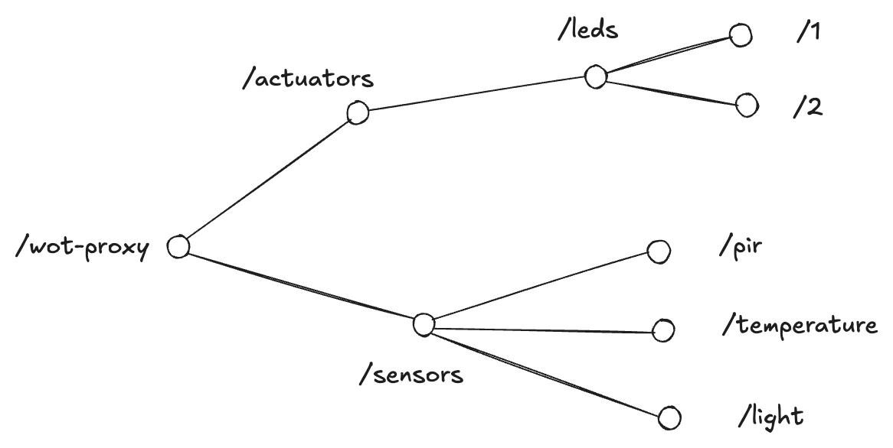
Resource Design
Consider the physical resources on our devices and map them into REST resources
Code: 01. Simple Thing

Slide 5
Server implementation
Create the Resource Model
map the device tree into a JSON file that the code will use to expose the right URL structure
see resources/resources.json
import the model into code
see resources/model.js
Create the Express routes
bind resources to URLs that our Web server will reply to
in Express the URL of a resource is defined by a route: app.METHOD(PATH, HANDLER)
we have two route files in the routes/ folder
see routes/actuators.js
see routes/sensors.js
Create an Express application
we need to load routes inside an HTTP server
see servers/http.js
HTTP server wrapped inside the Express framework
Create an entry-point for starting the server
see wot-server.js

Slide 6
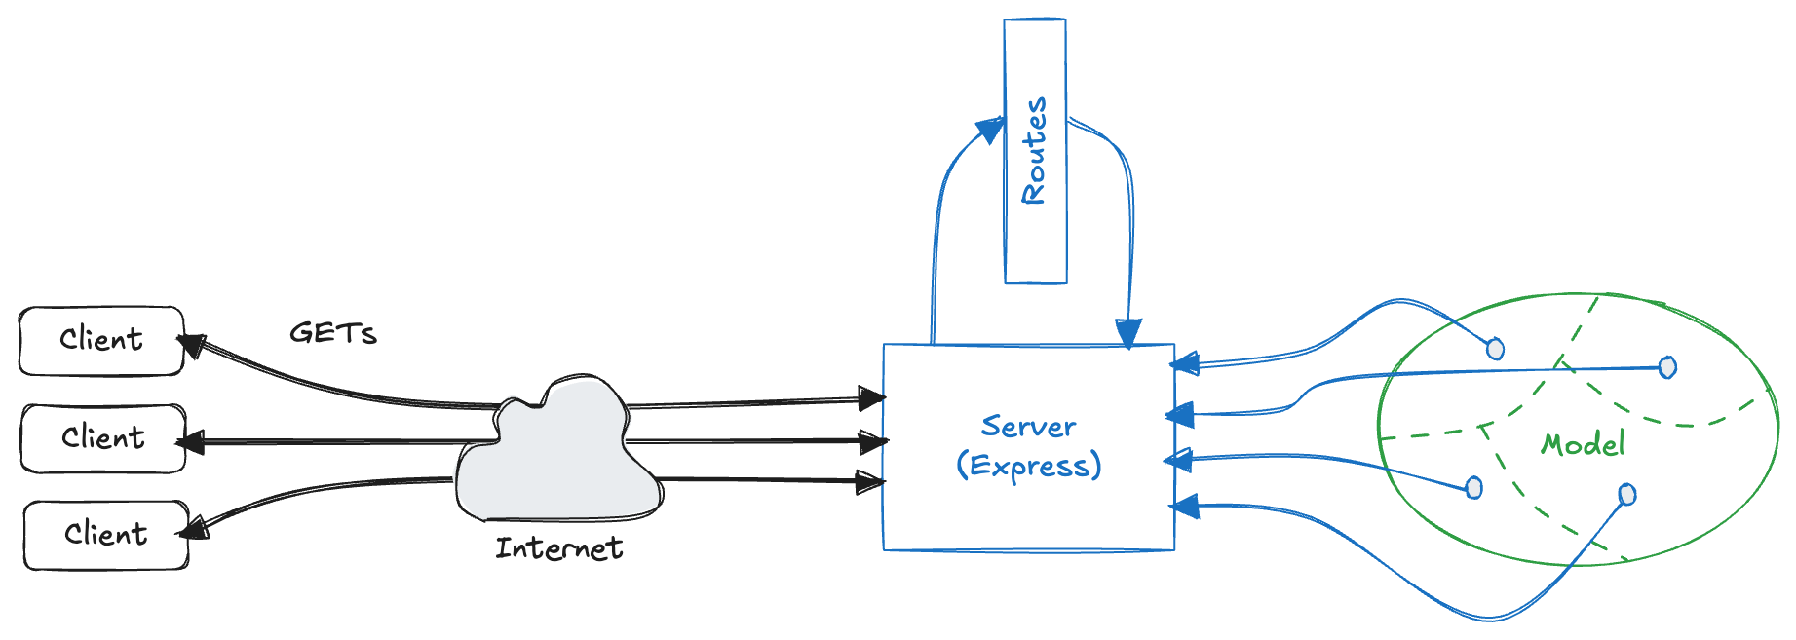
WoT Architecture - first version

Slide 7
Bind the sensors
Currently all we return is bits of the JSON model: real world data (e.g., the actual temperature) is missing!
Code: 02. Bind Sensors
Create a number of plugins, one per sensor or actuator
each plugin updates the model each time new data is read from the sensor
plugins should at least have the following functions:
start(), to start the plugin, accessible from other files so we export it
stop(), to stop the plugin, accessible from other files so we export it
connectHardware(), connect the actual hardware driver and configure it
simulate(), simulation mode, useful when developing with no sensors connected
see plugins/ folder
pirPlugin.js, tempPlugin.js, lightPlugin.js, ledsPlugin.js
Create the Arduino code to interact with real devices
see hardware/ folder
the code should be loaded inside the Arduino board
Integrate plugins into the server
require them from the wot-server.js file
start each plugin

Slide 8
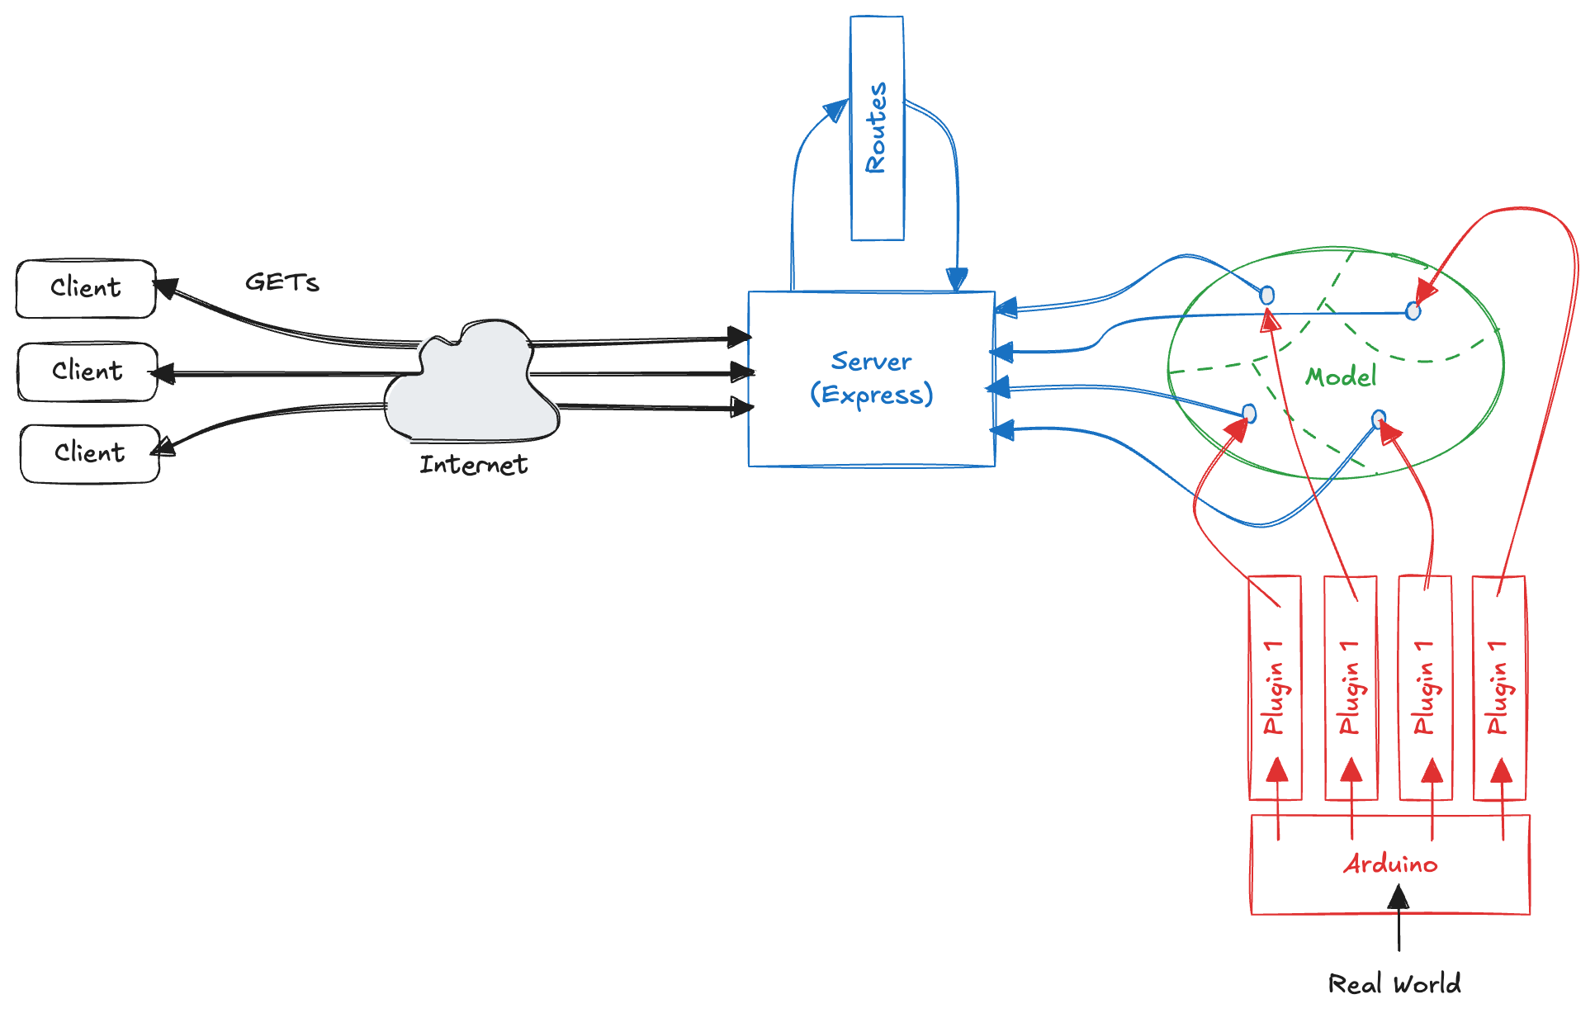
WoT Architecture - second version

Slide 9
Representation Design
REST is agnostic of a particular format or representation of the data
JSON is a must to guarantee interoperability, but it isn’t the only interesting data representation
HTML support allows for browsing API and discover resources in a human friendly way
Library: JSON to HTML (json2html)
MessagePack is a binary serialization format: can be mapped to JSON very easily, but is more compact than JSON
interesting for resource-constrained things over low bandwidth networks
Library: msgpack5
Code: 03. Multiple Representations
Middleware pattern
chaining functions that have access to the request (req) and response (res) objects in a request-response cycle
allows for extensibility while keeping the code clean and modular
used in several JS framework (also Express)
a middleware can execute code that changes the request or response objects and then decide to respond to the client or call the next middleware in the stack using the next() function

Slide 10
Representation Design
Implement the middleware supporting MessagePack and HTML
Install the two libraries via NPM
npm install node-json2html msgpack5
Implement the middleware pattern
see middleware/converter.js
Modify the routes so they call the next middleware in the chain (i.e., the representation converter) rather than answering the request directly
see sensors.js and actuators.js
replace all the res.send(resource) by req.result = resource and next()
Add middleware to Express application so that it gets called in the middleware chain
see http.js
The server is now capable of serving three different representations (JSON, HTML and MessagePack) for all the resources it offers
Accept: application/json
Accept: application/x-msgpack
Accept: text/html

Slide 11
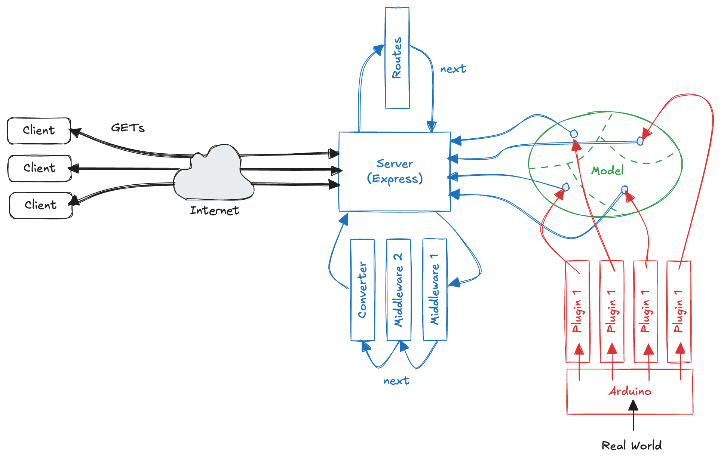
WoT Architecture - third version

Slide 12
Interface Design
We are only able to GET resources
What about the other verbs? What about HTTP status codes?
What about using WebSockets to subscribe to sensor data?
Code: 04. POST support
Adding a body parser
a middleware to get information from the body (at the beginning)
see http.js
Support other HTTP verbs
add support to update the state of the LEDs using a PUT request
see actuators.js
Bind actuators
the LED plugin that has a similar structure to the sensor plugins, but its goal is to observe changes in the model and report them onto the physical world
use the observable pattern (npm install node-observer)
see ledsPlugin.js and actuators.js
We can now update leds, with the appropriate JSON payload
see arduino.js
"value": true/false

Slide 13
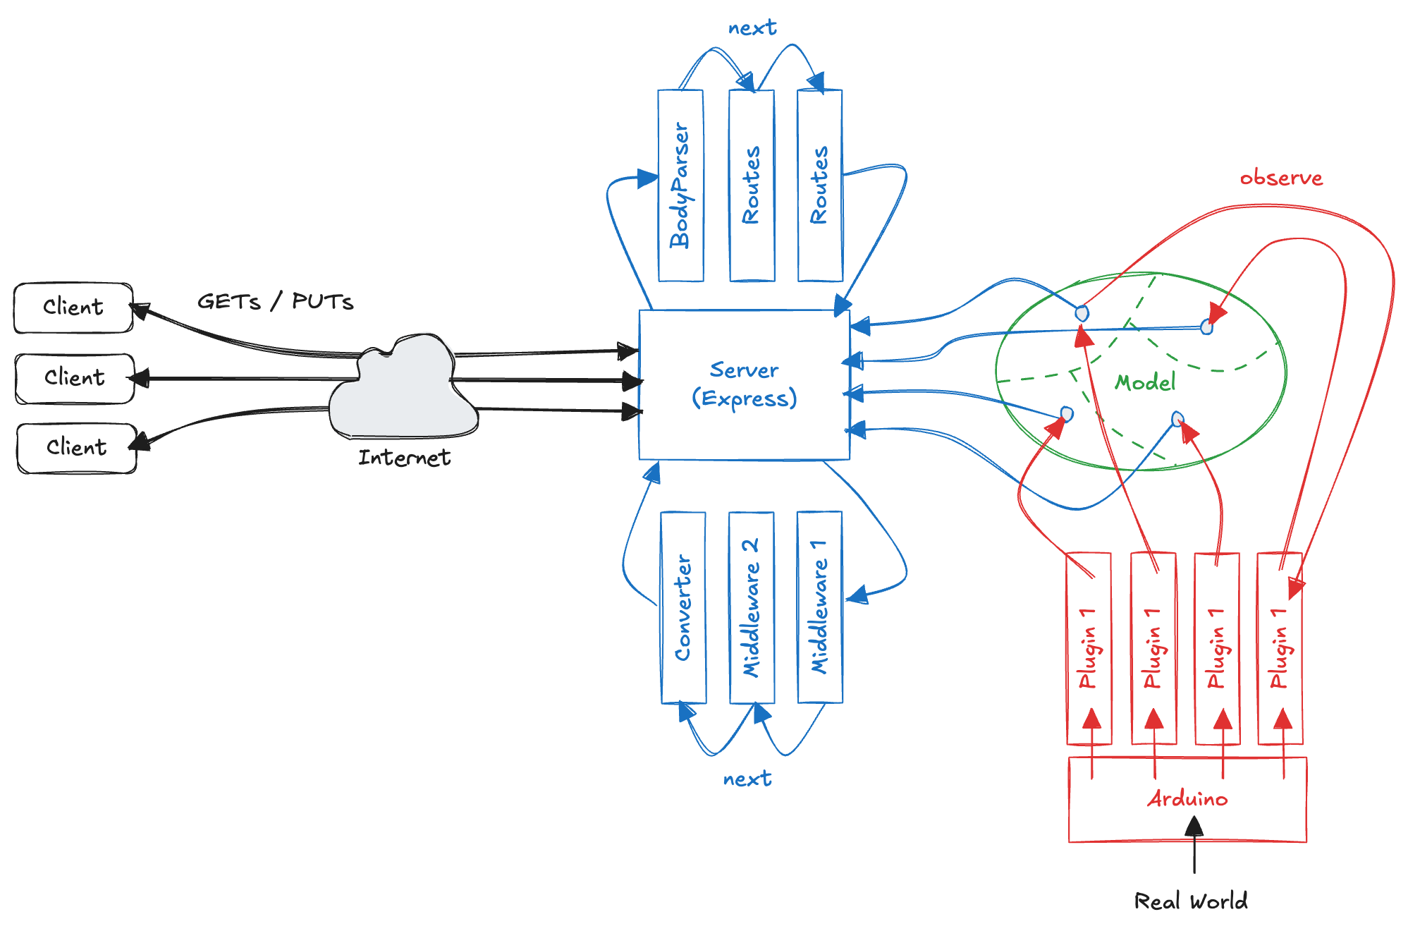
WoT Architecture - fourth version

Slide 14
Pub/Sub Interface via WebSockets
The goal is to offer the ability to subscribe via WebSockets on all our resources via a simple protocol upgrade to WebSockets
Code: 05. WebSocket
Node.js implementations
Socket.io (very powerful), WS (simple and effective), npm install ws
WebSocket listener
create a WebSocket server and attach a listener to the main HTTP server of Express to listen for protocol upgrade request
take these upgrade requests and use the URL of the request to observe the corresponding resource in the model
whenever a change is detected, propagate the change to the client via the open WebSocket connection
see servers/websocket.js
Initialize the WebSocket server after starting the HTTP server
see in wot-server.js
We can now subscribe to all the resources on the Web Thing with WebSockets and get informed whenever the state of a resource changes
see /public/webSocketsClient.html (in any recent browser)

Slide 15
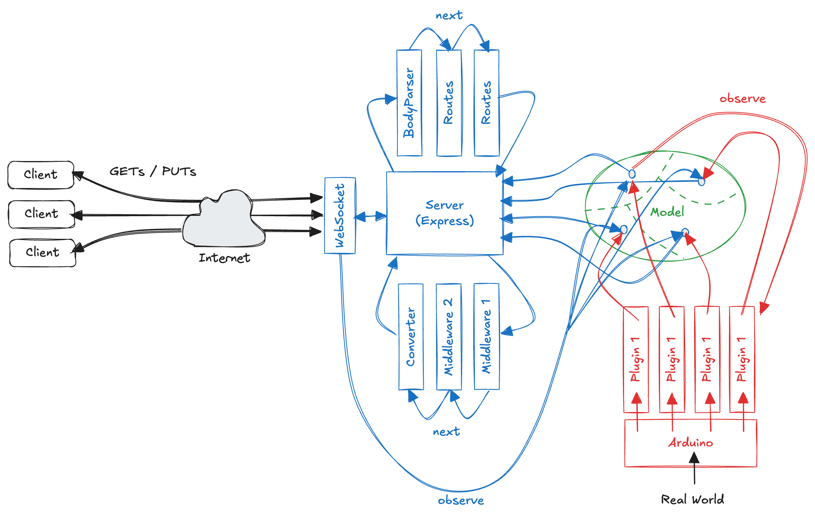
WoT Architecture - final version

Slide 16
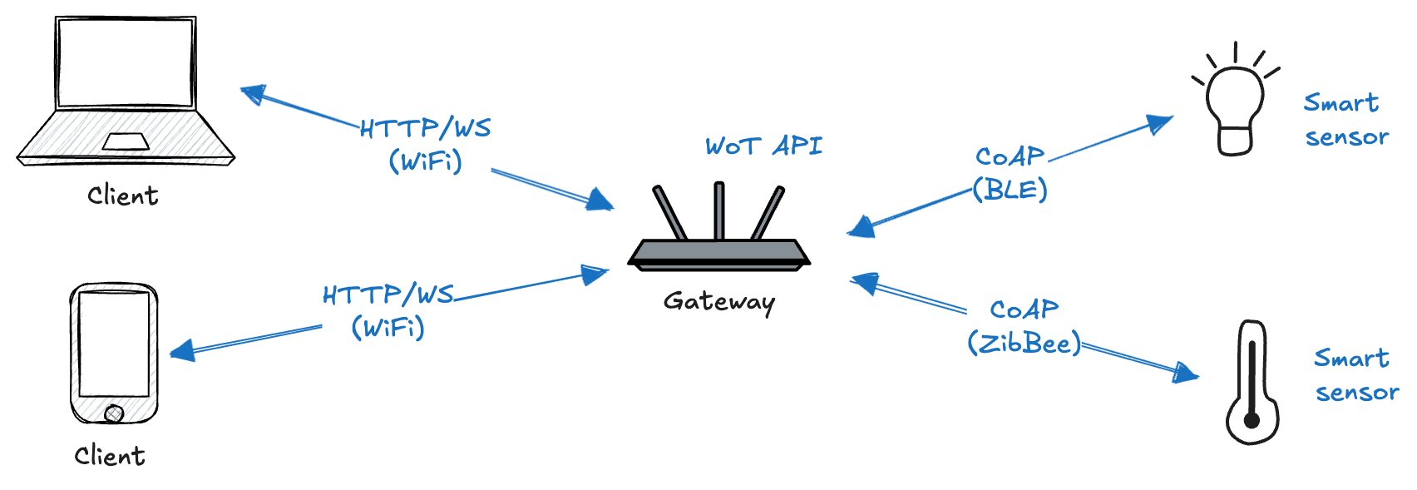
Other devices
Many real-world battery-powered devices and resource-constrained microcontrollers cannot connect over Wi-Fi or Ethernet and instead rely on low-power communication protocols
Bluetooth Low Energy (BLE) or ZigBee
Talk to devices using non-Web protocols
translates those into a clean REST API
add a layer of security or authentication
aggregate and store data temporarily
“fog computing”
expose semantic descriptions for devices that don’t have any

Slide 17
CoAP
Constrained Application Protocol
https://datatracker.ietf.org/doc/html/rfc7252
based on REST, not HTTP (UDP instead of TCP)
ideal for device-to-device communication over low-power radio communication
Code: 06.COAP
simulate a CoAP device
possible to run a COAP server on a resource-constrained device (e.g., Arduino Uno)
Simple server on Node
Node support for CoAP
npm install coap
see device/coap
run it (not possible to interact with this server from the browser: not HTTP)
Proxying CoAP via a Gateway
add a new model for the device (see model/resources.json)
create a CoAP plugin (see plugins/coapPlugin.js)
create routes for the new resource (see routes/sensors.js)
load the new plugin (see wot-server.js)
We can access the CoAP device through the Gateway using HTTP

Slide 18
Unit testing
A piece of code written by a developer that exercises a very small, specific area of functionality of the code
“Program testing can be used to show the presence of bugs, but never to show their absence!” [E. Dijkstra, 1972]
Generally, we have always done unit testing, manually
not structured, not repeatable, not on all your code, not easy to do as it should be
Example:
function sum(numbers) { let sum = 0; for(let i=0; i<numbers.length; i++) sum += numbers[i]; return sum; }
function testSum() { if(sum([1,2]) != 3) throw new Error(“1+2 != 3”); if(sum([-2]) != -2) throw new Error(“-2 != -2”); if(sum([]) != 0) throw new Error(“0 != 0”); }
Some writes tests after writing code, some before writing code and some in parallel with code. It is debatable which approach is better, but at the end all agree to the point that unit testing is critical part of development

Slide 19
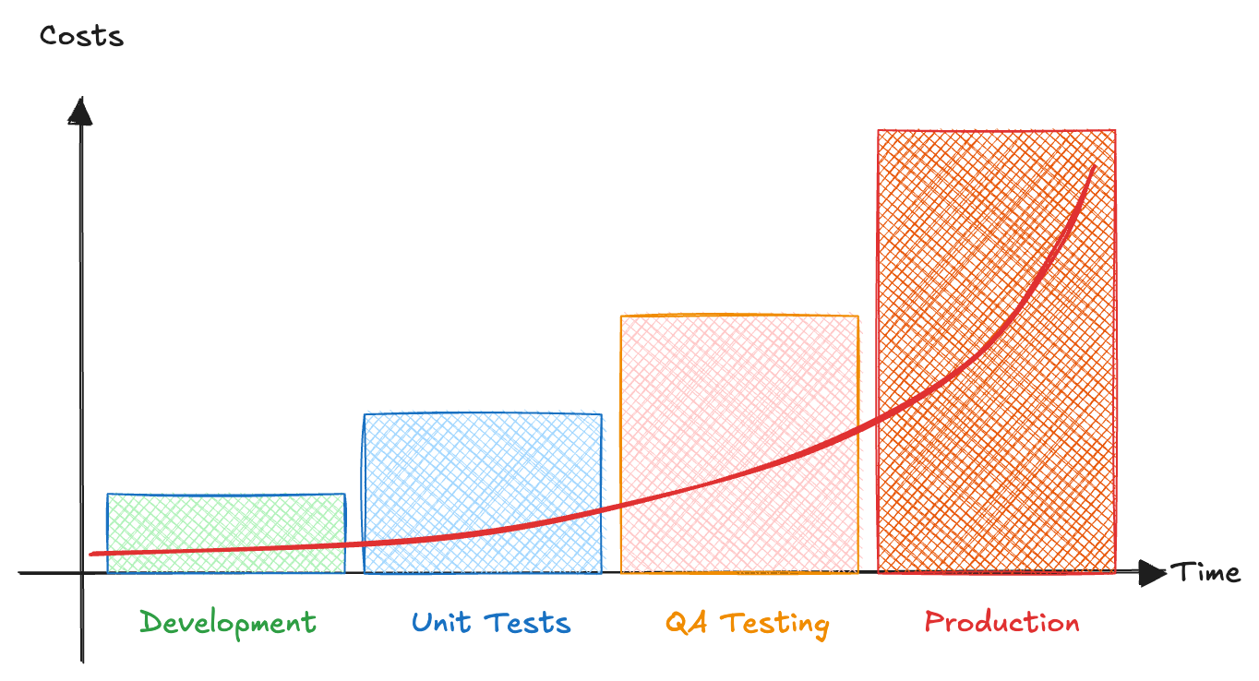
Bugfixing cost

Slide 20
Unit testing
UTs are specific pieces of code
In most cases UTs are written by developers, not by QA engineers
UTs are released into the code repo along with the code they test
Frameworks are usually used
QUnit, Jasmine, Mocha
Rules of thumb
all objects should be tested
all non-trivial methods should be tested
property getters and setters can be omitted
private methods can be omitted
all UT should pass before check-in into the source control repo
Pros
reduction in number of defects in code
improved design
good documentation (live)
reduction of the cost of change and refactoring
Moking
the object under test may have dependencies on other (complex) objects
replace the other objects using “mocks”, that simulate the behavior of the real objects

Slide 21
Mocha
let assert = require('assert'); describe('Basic Mocha String Test', function () { it('should return number of characters in a string', function () { assert.equal("Hello".length, 4); }); it('should return first character of the string', function () { assert.equal("Hello".charAt(0), 'H'); }); });
assert
helps to determine the status of the test
it determines failure of the test
describe
a function which holds a collection of tests.
takes two parameters, first one is the meaningful name to functionality under test, and second is the function which contains one or multiple tests
it
a function which is actually a test
takes two parameters, first parameter is the name of the test and second is a function which holds the body of the test

Slide 22
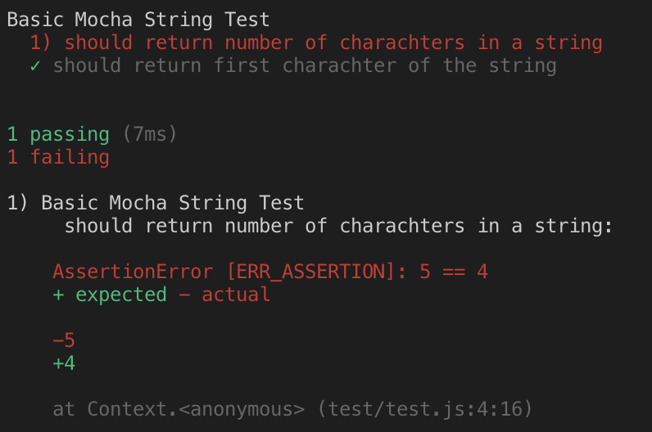
Run the test
Code: 07.Testing Examples\01.Basic
In package.json add dependency (notice: devDependency) and a command
"devDependencies": { "mocha": "5.0.1" }
"scripts": { "test": "mocha" }
npm test
The output show a summary of all tests (passed and failed):

Slide 23
Testing Actual Code
Testing Function
every function does a specific task
to test a function, it needs to be called from test with required inputs
then we will put assert to validate the output or task of the function
code: 07. Testing Examples\02.TestingFunction
Testing Asynchronous Function (callback)
we need to tell Mocha when the test is complete because of async nature
code: 07.Testing Examples\03.AsyncCallback
Hooks
We might want to execute some code before or after each test
to setup pre-conditions before test
cleanup after test
those code can be put inside beforeEach() and afterEach() methods.
Code: 07.Testing Examples\04.Hooks

Slide 24
Chai
An assertion library which provides natural language assertions,
expressive and readable style
can be paired with any testing framework
npm install chai
Interfaces
expect interface provides function for assertion
should interface extends each object with a should property for assertion
Example:
Code: 07.Testing Examples\05.ExpectShould
//assert.equal(isValid, true); expect(isValid).to.be.true; });
Chai provides expressive language and readable style like below:
Code: 07.Testing Examples\06.ChaiStyle
car.should.have.property('name').equal('Compass');
should.not.exist(car);
Support to test HTTP applications without having to start the server manually
chai-http

Slide 25
Test WoT Proxy API
Code: 08. Test WoT Proxy
We can add test code for the “temperature” route
add a “test” folder
see “test/temperature-test.js”
Add a new command in package.json
"test": "mocha"
We can add test code for the “measurement” route
We can also check our test coverage
a measure to describe the degree to which the source code of a program is executed when a particular test suite runs
a program with high test coverage has a lower chance of containing undetected software bugs compared to a program with low test coverage
many different metrics
the percentage of program subroutines
the percentage of program statements
npm install nyc

Slide 26
Hand-on Activities
Modify the model, the routes, etc. in order to add the support for three new sensors (e.g. humidity, wind and pressure)
Modify the model, the routes, etc. in order to add the support for a new actuators (e.g. a sprinkler) and provide a web page connected using Web Socket to the WoT Proxy in order to show a real-time temperature graph
Add test for the light route

